Slide 1

Introduction to Node.js
Melissa Kendall, June 2017

Slide 2
Resources

Slide 3
What is node.js?
Open source development platform
Published in 2011 (Linux only)
“JavaScript” on the server
Command line tool
Single threaded
Async, event-driven

Slide 4
Javascript is strange
"0" == false; //true
"abc" == "a" + "b" + "c"; //true
null == undefined; //true
30 -"7"; //23
"30" + 7; // 307

Slide 5
basics
console.log(“Hello!”); //write to console
function createFunction(var1,var3) { } //function
createFunction(9,[]); //non-static types
var newObj = { ‘nested’: { ‘var’: ‘a’ } }; //obj
var arr; arr = 2; arr = [ ‘2’ ]; //legal
0 == false //true
0 === false; //false, strict comparison

Slide 6
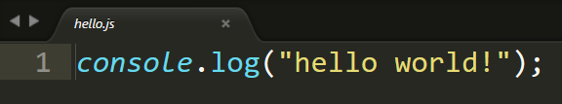

Hello world

Slide 7

Node Package Manager (NPM)
Cross-platform
Client and server
Quick to get up and running
Extremely flexible

Slide 8
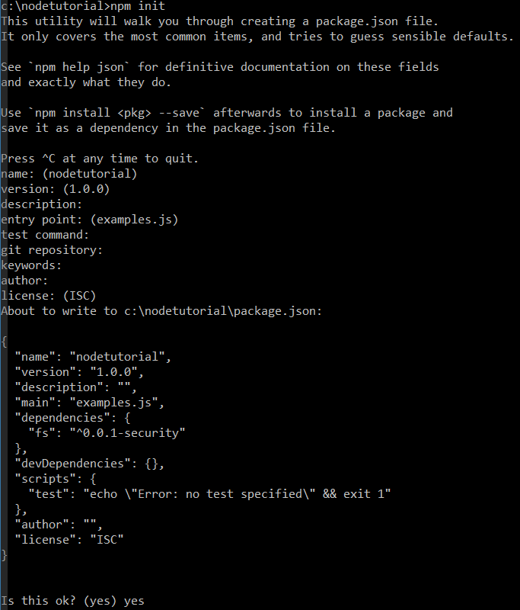

Slide 9

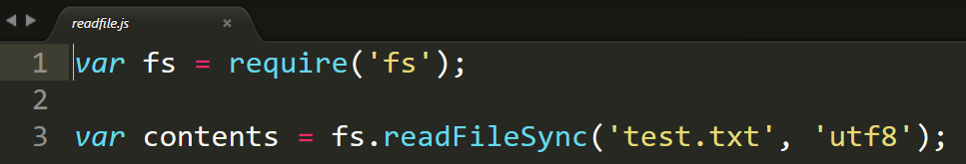
Read in file

Slide 10
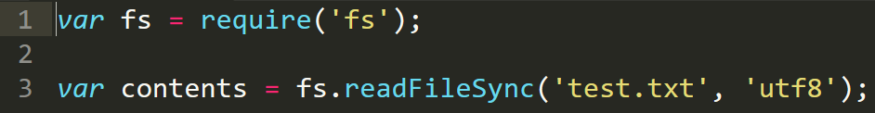
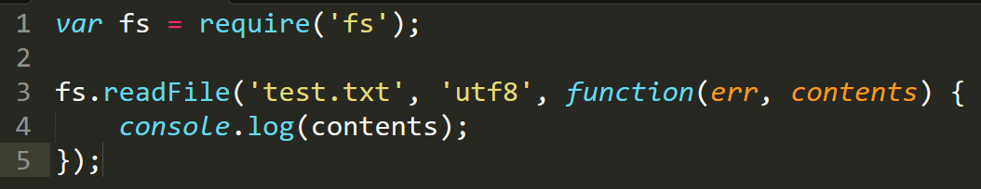
Async vs sync

Slide 11
Developer portal
API Specification – RAML
Server scripts – Node.js
HTML Templating – Nunjucks and Liquid
Guides – Markdown
Web server – GitHub Pages

Slide 12
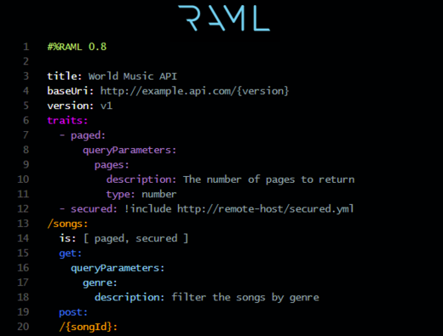

RAML

Slide 13
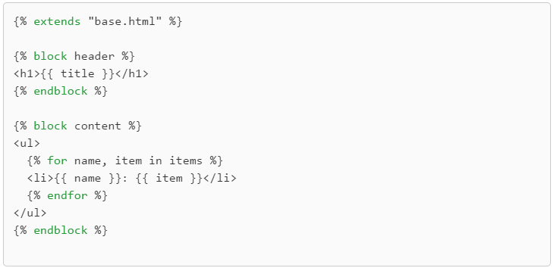
Nunjucks / Liquid

Slide 14
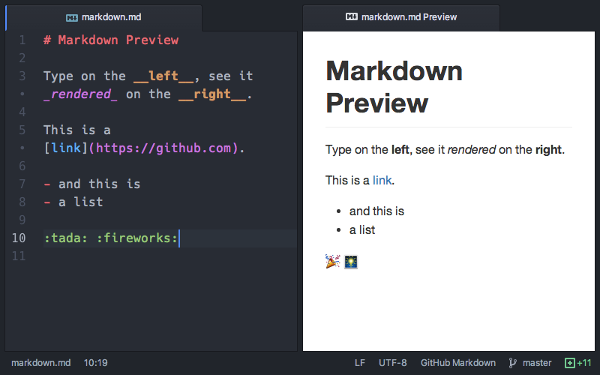
markdown

Slide 15
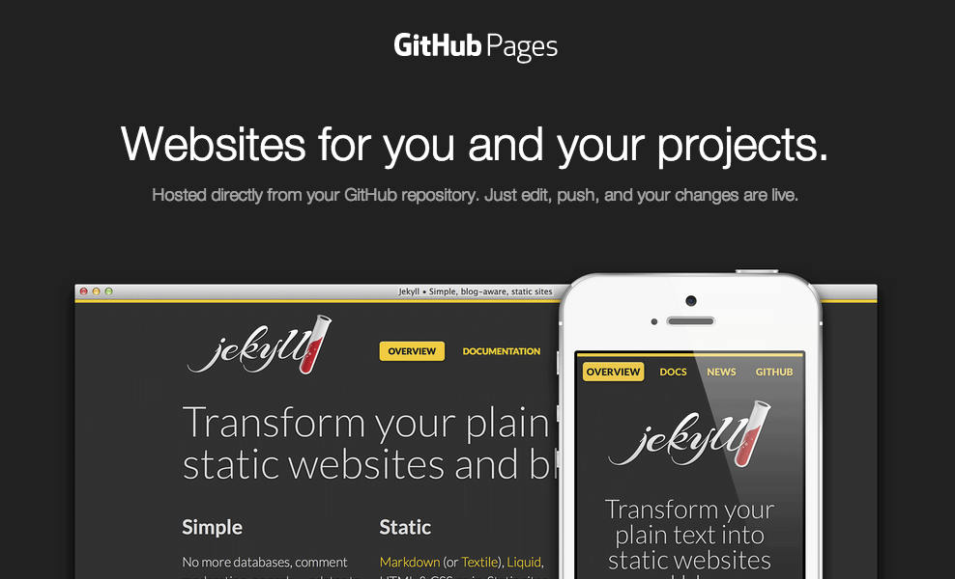
Github pages

